Slide 1
IP Routers
Lecture 7 (Routing 4)
Slides credit: CS 168 @ UC Berkeley
Notes:
Slides template credit: Josh Hug, Lisa Yan
okay so today's all about IP routers we're continuing the whole section on routing and so far remember
0:36
we've talked about distance Vector routing link state routing then we talked about using IP addressing to make
0:44
routing scalable today is kind of a detour before we continue talking about interdomain routing

Slide 2
IP Routers in Real Life
IP Routers
Routers in Real Life
Router Components (Planes)
Packet Types
Forwarding in Hardware
Efficient Forwarding with Tries
Lecture 7, Spring 2026
Notes:
So today we're going
0:51
to take a little bit of a break from routing protocols and we'll have a discussion on how do you actually build
0:58
a router in real life - what they look like, where they are, packet types, and forwarding hardware and algorithms

Slide 3
Routers – Conceptually
Recall:
A router performs routing protocols to learn about routes.
A router receives packets and forwards them according to the forwarding table.
Today: What do routers actually look like in real life?
B
R2's Table
Destination | Port
A | 0
B | 1
C | 1
D | 2
R3
0
1
C
A
R1
R2
2
R4
D
Notes:
so you've already
1:04
seen these conceptual pictures where we say you have this square and it represents a router and it performs
1:11
routing protocols with other routers to learn about routes to destinations it fills in this table and then when it
1:18
receives packets it forwards the packets out of the links based on what the table
1:23
entry says so it's all things you've already seen but today we're going to remove the abstraction that shows just a
1:30
square and actually answer the question of what this thing looks like in real life and then next time we'll come back
1:37
and talk more about interdomain routing

Slide 4
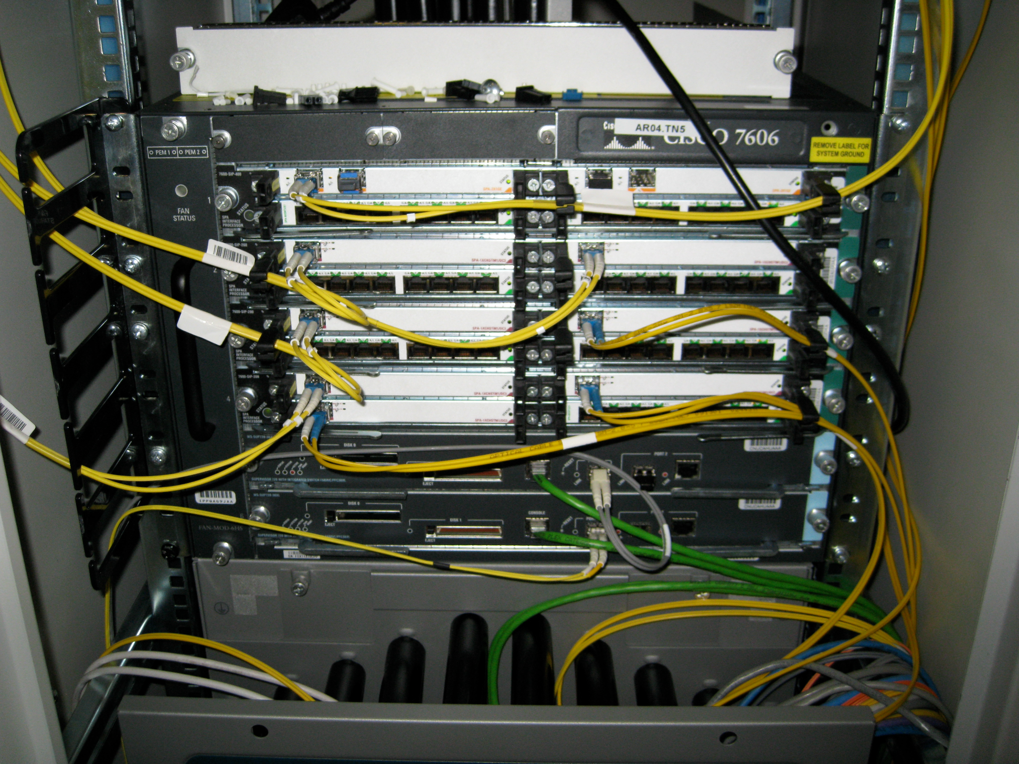
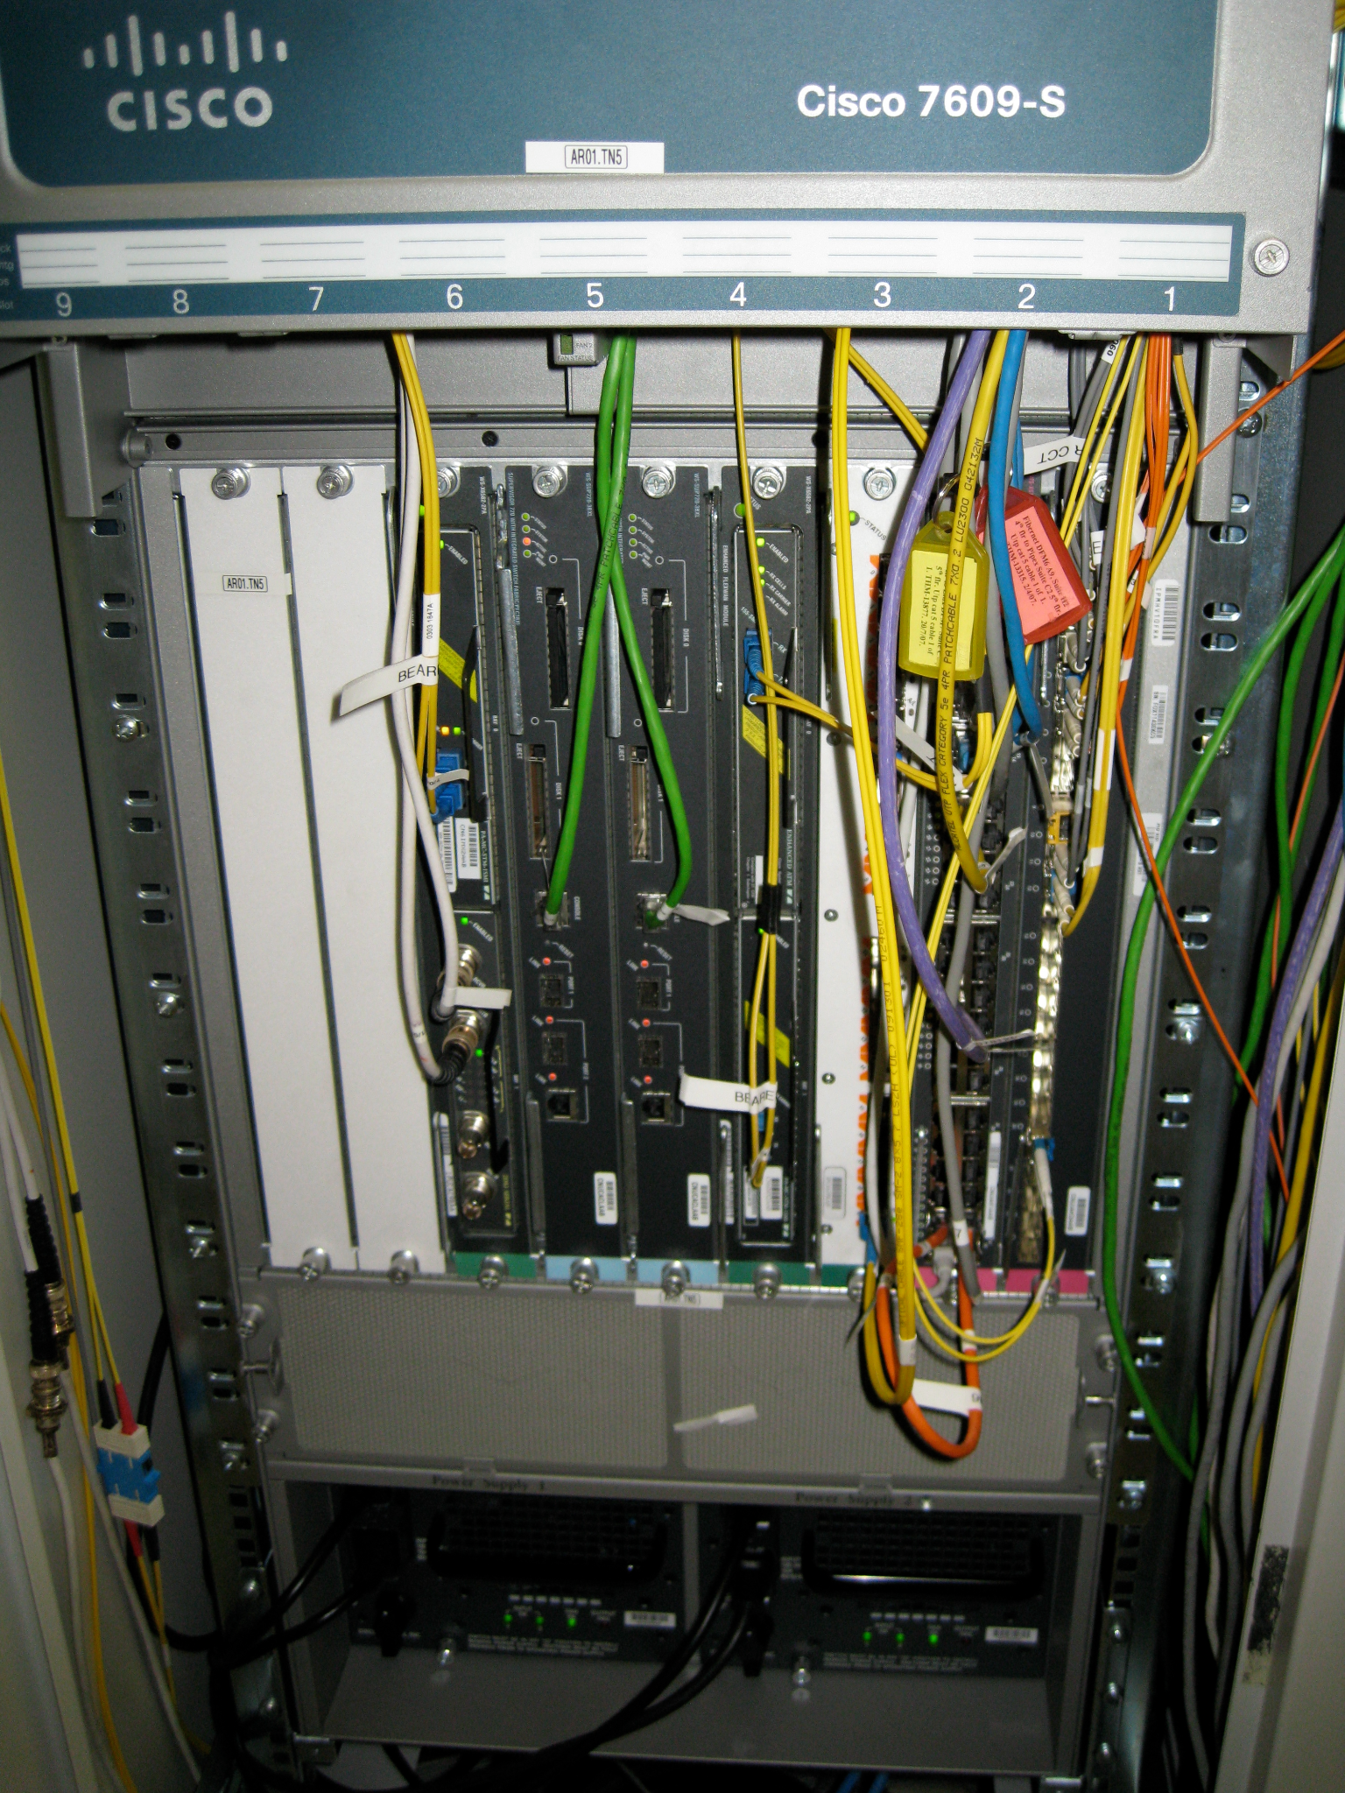
Routers in Real Life
A router is just a computer specialized for forwarding packets.
Notes:
so what does the router actually
3:05
look like it's not a square in real life it looks something more like this and ultimately all that it is it's a
3:11
computer that's really good at forwarding packets so it's a computer with a CPU just like any other computer
3:18
like your laptop except that instead of browsing the web or playing games the
3:23
router's job is just to receive and forward packets so it is a computer that looks like any other server computer but
3:30
instead of serving you YouTube videos or letting you play games it's just
3:36
forwarding packets

Slide 5
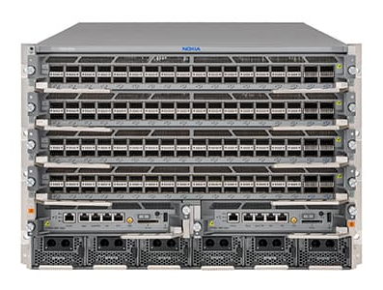
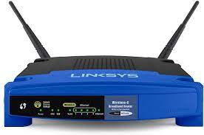
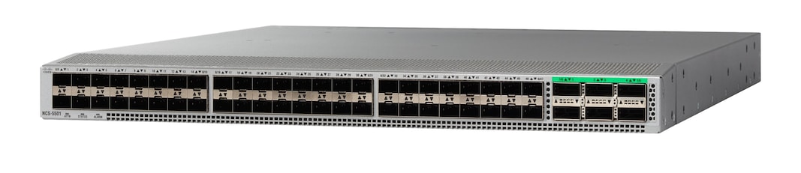
Measuring Router Size
Different dimensions for measuring the size of a router:
Physical size, number of ports, bandwidth.
Capacity = number of ports × speed of each port.
The speed of a port is sometimes called its line rate.
Example:
A home router might have four 100 Mbps ports, and one 1 Gbps port.
Total capacity: 1.4 Gbps.
Notes:
there are also different sizes of routers so the one in your home is
3:42
probably one of these stinky little ones and that's enough to support the traffic on your home network you could also get
3:48
a larger one and here when we mean larger we don't just mean the physical size although this is probably larger
3:55
but we also mean the number of ports and here we're talking about physical ports not logical ones so these are the
4:02
physical ports that the actual holes in which you would plug in cables and you can see this one has way more ports than
4:08
this tiny one which has maybe three or four so when we say size we mean
4:13
physical size but we also mean number of ports maybe also the bandwidth of the links that you connect to these ports
4:20
and how much data that Port can read and write at any given time and if you want a really big router you can go and get

Slide 6
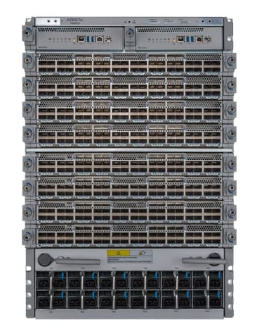
Modern Router Capacity
Modern router:
Up to 288 ports.
400 Gbps line rate per port.
Capacity = 115.2 Tbps.
Next-generation router:
Up to 288 ports.
800 Gbps line rate per port.
Capacity = 230 Tbps.
Innovation is focused on improving line rate, since we're running out of physical space to add more ports.
Notes:
so your home probably doesn't have one that's person sized but those big data centers or
5:54
collocation facilities they will have routers that are this big and here's just an example of the specs of a router
6:01
like this so as an example a modern router might have say 288 ports that's a
6:07
lot of ports you can plug in 200 cables into this router each Port supports
6:13
something like 400 gbits per second of line rate that's a lot of data that you're sending per second along those
6:20
wires and if you add them all up you get some capacity that's in the order of hundreds of terabits per second so this
6:27
thing is receiving and forwarding hundreds of terabits every second which is pretty impressive and the Next
6:34
Generation router these are the ones that people are currently designing and building so they haven't really been
6:39
deployed yet on the entire internet but people are designing them and thinking about what these would look like the
6:45
Next Generation router will have probably the same number of ports but the line rate is going to increase and
6:51
that's going to cause the total capacity to increase as well and in case you're wondering why did they try to increase
6:57
this number but why did they keep the 288 the same it's because we're simply running out of space to shove more
7:03
physical ports there's just no more space on this personized router to plug
7:08
in more cables so instead we have to make each Port higher capacity so this is an example of what people are
7:16
designing nowadays when they talk about the highest performance
7:21
routers

Slide 7
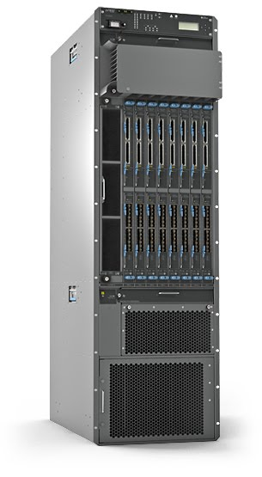
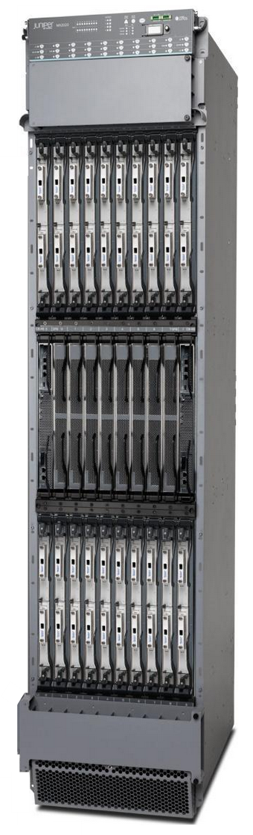
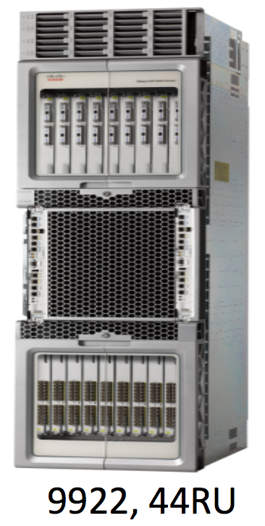
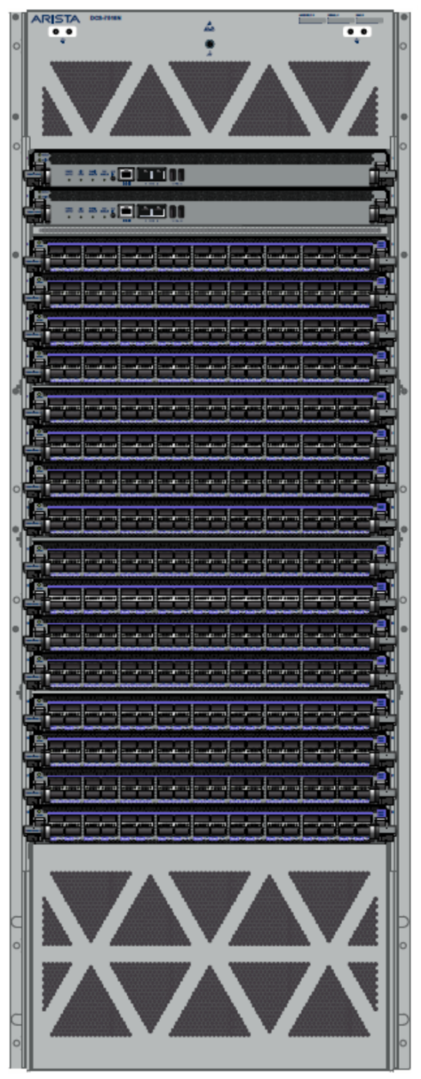
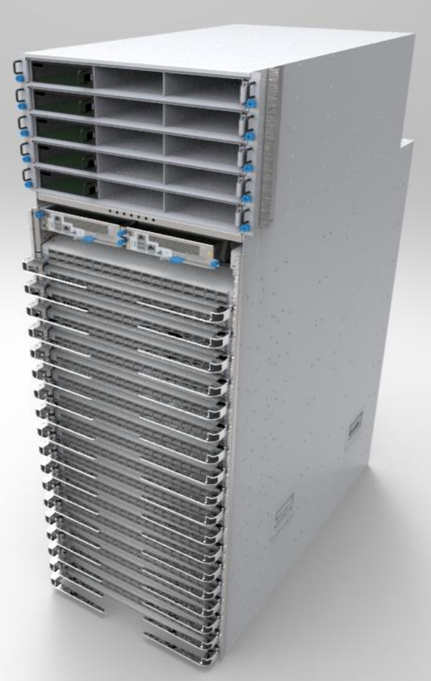
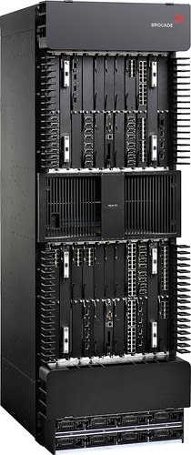
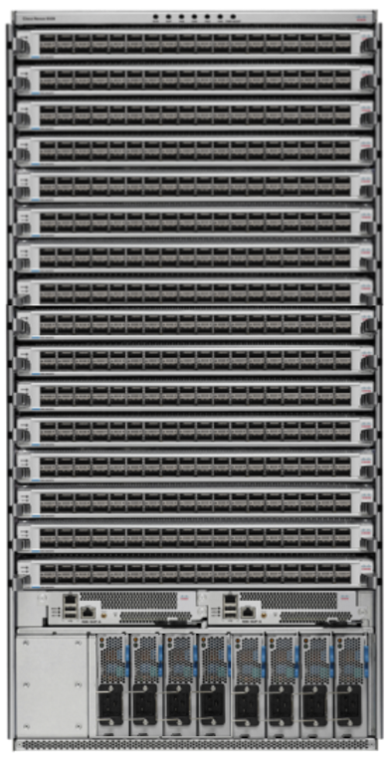
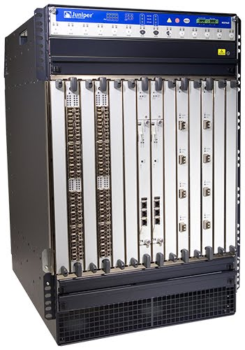
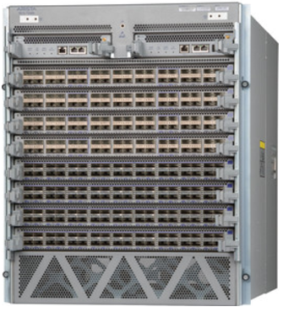
Evolution of Router Capacity
Modern routers are facing physical constraints: size, power, cooling, etc.
Rate of growth is slowing: 10G → 100G → 400G → 800G.
Juniper/Cisco/
Arista lean core
Juniper/Cisco/
Arista lean core
Juniper/Cisco/
Arista lean core
Brocade MLXe
Juniper PTX5000
Cisco ASR9000
Arista 7500R
Juniper MX3D
Juniper MX2020
28T
50T+
100T+
200T+
1.76T
2.56T
3.84T
8T
16T
10G
100G
400G
2010
2011
2012
2013
2014
2015
2016
2017
2018
2019
Notes:
so here's another picture of the evolution of routers you can see that they have gotten larger and they have
7:27
also increased in capacity and the rate of growth is increasing but I would say
7:33
it's slowing down a little bit so for example from 2013 to 2016 we went from
7:39
10 gigabits per second to 100 gbits per second that's pretty impressive but then
7:44
from 2016 to 2019 we only increased from 100 to 400 so the rate went from 10
7:50
times increased to four times increase and then the next Generation which is 800 gbits per second that's only a two
7:57
times increase so the amount of benefit we can squeeze out of these routers is
8:03
starting to Plateau a little bit but we're still doing our best to increase the performance of the state-of-the-art
8:09
routers you don't have to memorize any of these numbers by the way but just a brief history on what routers have
8:15
looked like over the years so that's what a router looks like
8:21
in real life

Slide 8
Router Components (Planes)
IP Routers
Routers in Real Life
Router Components (Planes)
Packet Types
Forwarding in Hardware
Efficient Forwarding with Tries
Lecture 7, Spring 2026
Notes:
now we can dig inside a router and open it up and see what
8:26
Secrets it's hiding what Hardware do you actually put in the router so that it's
8:31
able to forward packets and do whatever else it has to do

Slide 9
Router Planes
The components of a router can be split into 3 planes:
The data plane handles forwarding packets.
Used every time a packet arrives: Nanosecond time scale.
Operates locally. No coordinating with other routers.
The control plane performs routing protocols.
Used every time the network topology changes. Second time scale.
The management plane lets the operator interact with the router.
Operator uses network management system (NMS) to interact with router.
Tell the router what to do, and monitor what the router is doing.
Time scale of seconds/minutes.
Example: Assigning costs to links.
Example: How much traffic is being sent on each link?
Each plane is optimized for its tasks and its time scale.
Notes:
the first thing we should talk about is what the
8:37
router actually has to do and you can split up the tasks that the router has to do into three planes
8:45
plane has some Hardware that's specifically good at doing the tasks in
8:50
that plane so the first plane is called the data plane and then we'll have some specific Hardware that's very good at
8:56
data plane operations this is how you forward packets so data plane is responsible for one thing and that is
9:02
when a packet arrives look it up in the forwarding table send it out along the
9:08
proper link that's it so anytime a packet arrives use the data plane to forward it and the time scale that the
9:15
data plan operates at is something like order of Nan seconds because packets are
9:20
arriving all the time remember the capacity of these things is like terabits per second so you're receiving
9:26
like millions of packets every single and the data plane has to be able to process each one look up the next top
9:33
and send it out as fast as possible and this is a local operation as we've already seen you only need the local
9:40
forwarding table to decide how to forward a packet you're not really talking with anyone else you're just
9:46
receiving a packet forwarding it and that's it it's a job that only the router can do by itself doesn't really
9:52
have to talk to other people by contrast the other plane that we'll talk about is
9:58
the control plane this is where the routing protocols actually happen so remember in distance vector or link
10:04
State the routers had to talk to other routers around it to learn about routes
10:10
to other destinations and fill in the forwarding table so the control plane is where you actually fill in the
10:16
forwarding table by running some routing protocol so remember that difference between forwarding and routing it pops
10:23
up again here when we're designing the router itself the control plan is responsible for doing the routing
10:29
and talking with other routers around it to learn about what you go in the forwarding table and the time scale for
10:36
this is a little bit slower actually a lot slower because it's not like you have to send millions of advertisements
10:43
per second that's a lot of advertisements instead you only have to recompute routes every time the network
10:50
changes so remember we said that eventually the routing protocol would stabilize it would become steady state
10:58
and then something would and then everyone would talk to each other and learn the new routes and then it would stabilize again or converge again so
11:06
roughly speaking I would say that the time scale on which the network topology changes is like once every couple of
11:14
seconds so every few seconds someone new joins or someone new leaves and we have
11:19
to update our table so notice that the time scale of these things is also very different forwarding packets has to
11:25
happen millions of times per second and updating your forwarding table happens
11:30
once every couple of seconds this also means the hardware that we use for these two is going to look different one of
11:37
them has to be optimized for nanc time scale the other one for once every
11:42
couple of seconds time scale and the third plane is one that we haven't seen
11:47
yet but it's very important to routers and it's called the management plane this is how you as the network operator
11:54
interact with the router so you might want to tell the router some information maybe you want to assign a static route
12:02
and manually program the forwarding table maybe you want to tell the router the costs on each link you want to say
12:08
this link is cost 10 and this link is cost 20 that's something you might want to tell the router so if you ever want
12:15
to talk to the router as a human you have to use the management plane and
12:20
then in the other direction the router can also report any debugging information or analysis information back
12:27
to you the humans so it works both ways so you can tell the router information like this link costs 10 and the router
12:35
can also tell you information like this link is really busy and it's got a lot of packets and this link is not being
12:41
used at all so the router can also tell you some diagnostic information or if
12:47
there's an error the router can tell you what went wrong so that's what the management plane is for it lets you
12:53
interact with the router and the time scale here is something more like seconds or minutes so you're probably
12:59
not talking to the router millions of times per second that would be a lot of things to say instead you're probably
13:06
talking to the router once every couple of minutes and saying hey this link cost changed or tell me something about the
13:13
analytics so the time scale here is much more sparse compared to the data plane
13:19
so now that we know these three different planes when we actually build a router in Hardware we can build
13:24
Hardware that optimizes for each of these three different planes which is pretty useful

Slide 10
What's Inside a Router? – View of Components
Chassis
Chassis: The metal box holding the hardware.
Controller Card
Control processor: Runs routing protocols and puts forwarding tables on linecards.
Also handles management plane.
CPU
Linecard
Removable linecards gives us flexibility in scaling the router. 1–20 linecards per chassis.
CPU
Linecard
CPU
Each linecard has several ports. A port can be used for both input/output.
Linecard
CPU
Each linecard has some hardware to control its functionality.
Notes:
okay time to open up a router and see what's inside so the outer part of
13:38
the router is just a box like a metal box sometimes it's called a chassis if I go back and look at these pictures you
13:44
can see they're all enclosed in big metal boxes so that's the chassis it's not like Hardware it's just a box and
13:52
then inside of the Box usually what we'll have is well first we have a CPU
13:58
so this is just like any other computer your computer has a CPU my computer has a CPU and the router which is also just
14:05
a computer it also has a CPU and this CPU is usually responsible for the
14:10
control plane and the management plane so things like talking to the operator
14:16
and running routing protocols usually the controller is responsible for that
14:21
and it's got a CPU to think and run those operations and then in addition to the
14:27
controller card this is the part that your computer doesn't have we have one or more usually quite a few line cards
14:35
and if you go back and look at some of those routers I'll see if I can find a picture see how there's like these slots
14:40
where you can insert something so it's this big tray and then you can insert things into the tray well the things
14:46
that you're inserting are these line cards in cartoon format and a line card you can insert it you can remove it so
14:53
it's removable and if you want the router to scale up you add more basically each line card has a bunch of
14:59
ports so here I'm drawing these green squares as ports where you can plug in wires and usually the line cart also has
15:06
some CPU to control whatever it is the line card is doing so you can think of it like this is this big metal box you
15:14
plug in a controller card that does the routing protocol and the management stuff and then you plug in as many line
15:20
cards as you need and each one has ports and it also has a CPU to help it perform
15:26
any operations it has to so at a very high level when you open up a router you
15:31
might see something like this

Slide 11
What's Inside a Router? – View of Links
Chassis
Controller Card
Controller card is connected to the linecards.
Linecard
Fabric
Linecard
Each linecard is connected to the fabric: A bunch of wires providing high-bandwidth, fault-tolerant interconnection between linecards.
Linecard
Linecard
Linecard
Linecard
Notes:
we need some connections between the line cards it's not enough just to slot in a bunch of
16:03
line cards they all have to connect to each other in some way and the way that you do that is something called the
16:10
fabric and think of this like a bunch of wires connecting all of the line cards so you could imagine this like a whole
16:16
mesh of wires maybe it's something else but basically all that's in this fabric is lots and lots of wires that make
16:23
every line cart interconnected with each other and there's usually some fault tolerance so for example if one of the
16:29
wires breaks there's still some path between line cards and it's usually very high bandwidth because we want to
16:36
support terabits per second of data but this is how you connect up all the line cards they all have to connect through
16:42
some fabric and also the controller card has to be connected to the line cards because remember the controller card is
16:49
the one performing the routing protocol so if the forwarding table changes the controller card has to go and tell
16:55
everyone hey there's a new forwarding table entry that you have to use so control plane up here data plane down
17:02
here and then the fabric interconnects everyone so that data can be sent between different line

Slide 12
What's Inside a Router? – View of a Linecard
Linecard
CPU
Forwarding Chip
Forwarding Chip
Specialized hardware optimized to forward packets.
Fabric Chip(s)
Sends packets into the fabric, to other ports on the router.
To Fabric
Notes:
and now we zoom in onto the line card so what's on a line card there's lots of ports we've already seen those
17:18
those are the green boxes in the cartoon there's a CPU that helps with things like debugging or if there's an error
17:25
that's pretty useful and then you could write the forwarding code in Hardware if
17:31
you wanted to like I could open up a c program and I can write something like
17:37
well if the packet comes in please look up these bits and then look it up in the forwarding table and then forward it
17:43
kind of like what you did in the routing project you could write that in code but it turns out that software is actually
17:49
too slow to handle the capacity that we want on Modern routers so you could just
17:55
go to the CPU write a piece of python code or C code like what you did in the project and that will forward packets
18:02
correctly but it's way too slow software is just too slow for this purpose so instead we actually turn to Hardware we
18:10
build on the chip the instructions for looking things up in the forwarding table and then forwarding it directly so
18:17
if you've taken a computer architecture class like cs61c or something you've probably heard that Hardware is much
18:23
faster than doing things in software and if you haven't I guess you'll just have to trust that that's true but Hardware
18:29
is much faster than software so writing the code will work but it's very slow
18:35
directly programming what you need to do and burning that functionality onto the chip is even faster so this is the
18:43
circuit like an actual circuit with wires and logic gates that computes the
18:48
next toop and then sends the packet out of the next toop without having to write any code which is pretty useful so a lot
18:54
of work goes into designing these chips to work really quickly and there's also a chip for forwarding packets to other
19:01
line cards so for example if something comes in on this port and you need to send it on a different line cards output
19:07
Port then we need to figure out what wires on the fabric to send it along so there's possibly also some chip that
19:14
figures out where the packet needs to go in the fabric but the key idea here is
19:19
just that everything's done in Hardware not in software because it's faster and we care about things being really fast

Slide 13
What's Inside a Router? – Full View
Chassis
Controller Card
Control Processor (x86)
Linecard
Linecard
Fabric
Fabric
Forwarding Chip(s)
Fabric Chip(s)
Fabric
Fabric Chip(s)
Forwarding Chip(s)
Local CPU (x86)
Local CPU (x86)
Notes:
19:26
so putting all the pieces together if I had to draw a picture of the router it would look something like this you have
19:32
this controller card that you slot in and it has a processor just like your own computer this is where the
19:38
management happens and then you have all these line cards that you slop in and they all have forwarding chips for
19:44
forwarding things really quickly they have a CPU for debugging and other miscellaneous tasks and then there are
19:51
these fabric trips fabric chips that connect to the fabric which is just a bunch of wires hooking up all the line
19:58
cards and in reality it's that big metal box with lots of line cards slotted
20:05
in any thoughts on the picture
20:11
okay

Slide 14
What's Inside a Router? – Data Plane
Data: Packet travels from port to port, via forwarding chips and fabric.
Chassis
Controller Card
Control Processor (x86)
Linecard
Linecard
Fabric
Fabric
Forwarding Chip(s)
Fabric Chip(s)
Fabric
Fabric Chip(s)
Forwarding Chip(s)
Local CPU (x86)
Local CPU (x86)
Notes:
so now that we have a full picture of the router we can think about what
20:16
parts are responsible for each of the three planes so we already said the data plane is handled by the line cards
20:24
packets come in on the port you send them to the forwarding chip which figures out the next toop if the next
20:30
toop is on a different line card then we send that packet through the fabric which is a bunch of wires we find the
20:36
correct output line card and then we send the packet out of the correct Port so all of this is being done between the
20:42
line cards and notice that the controller card is great out here it doesn't participate in forwarding only
20:48
the line cards have to work on forwarding

Slide 15
What's Inside a Router? – Control Plane
Control: Controller card talks with other routers, and programs linecards with routes.
Chassis
Controller Card
Routing Protocol
Other Routers
Control Processor (x86)
Linecard
Linecard
Fabric
Fabric
Forwarding Chip(s)
Fabric Chip(s)
Fabric
Fabric Chip(s)
Forwarding Chip(s)
Local CPU (x86)
Local CPU (x86)
Notes:
then we have the control plane and now the line cards are mostly
20:55
grayed out because we don't use the line cards to run routing protocols the routing protocol is run by the
21:00
controller CPU so this guy talks to other routers using distance Vector link
21:06
state it sends advertisements it receives advertisements and it programs
21:12
forwarding tables accordingly and if it does learn an updated forwarding table it does have to go to the line cards and
21:18
these forwarding chips and say hey the forwarding table is actually changed so let me burn the new forwarding table
21:24
onto this chip so that you know what the correct lead is forward ing table is so there's some like memory on here or
21:31
something and you write the new forwarding table on that memory so these are the things that are active in the
21:38
control plane

Slide 16
What's Inside a Router? – Management Plane
Management: Controller card talks with operator.
Chassis
Controller Card
Configuration System
Configuration
Diagnostics
Monitoring System
Control Processor (x86)
Linecard
Linecard
Fabric
Fabric
Forwarding Chip(s)
Fabric Chip(s)
Fabric
Fabric Chip(s)
Forwarding Chip(s)
Local CPU (x86)
Local CPU (x86)
Notes:
and finally there's the management plane we already said this is done by
21:43
the controller card no one else has to participate in this and it can output
21:49
Diagnostics like telling you about analytics and what links have been used and what links haven't or if something
21:55
has gone wrong and it can also receive configuration from the user so it talks
22:01
to the operator and does configuration or
22:08
Diagnostics

Slide 17
What's in a Router?
A router is really a cluster of computers specialized for forwarding packets.
"06" = 6 slots:
2 controllers, 4 linecards
Linecard
Fan Tray
Controller Card
Notes:
so here is the picture of the router that you saw earlier we can actually break it down now so it's kind
22:14
of hard to see but if you squint you can see that these are the line cards you see how there's like a slot and you can
22:20
slot the line card itself with the chip and the ports into one of these slots
22:25
which is kind of useful there's a controller card which I am told is down here I have never touched this router in
22:31
real life but the controller card is apparently down here so you slot that in and it has a CPU on it there are a bunch
22:37
of fans cuz this thing gets hot and you have to cool it like your computer but even hotter and supposedly I am told
22:44
that the 06 up here stands for the fact that there are six slots where you can put things in so you can slot in four
22:51
line cards two controllers that is apparently what the six means from the manufacturer but I've never touched this
22:57
so we'll take the word of what the slide says but really what this means is the router isn't really just one computer
23:03
with one CPU that's forwarding packets it's a lot of computers with all these different chips across different slots
23:10
for forwarding packets that's kind of cool it's a view inside of the
23:19
router okay any thoughts on the tour inside of a router

Slide 18
Packet Types
IP Routers
Routers in Real Life
Router Components (Planes)
Packet Types
Forwarding in Hardware
Efficient Forwarding with Tries
Lecture 7, Spring 2026
Notes:
okay now that we've taken a tour of what's inside the routers let's think about the different packets that the
24:12
router has to process throughout its lifetime there's three types of packets that the router can receive

Slide 19
Types of Packets
3 types of packets can arrive at a router.
User packet: The router needs to forward this packet toward its destination.
Most common type of packet.
Forwarding chip looks up which port to forward this packet.
If outgoing port is on a different linecard, send packet through fabric to that linecard.
Control plane traffic: Packets intended for the router itself.
Example: Advertisements in routing protocols.
Forwarding chip sends the packet to the controller for processing.
Punt traffic: Packets intended for the user, but requiring extra processing.
Example: Packet TTL has expired. Need to send back an error message.
Forwarding chip "punts" the packet to the controller for processing.
Notes:
ow we can think about what parts of the router have to handle them there's the user packet this
24:24
is packets with data in them that the P the router house to forward you've already seen these before these are the
24:31
packets that you're forwarding back and forth during routing and usually this is
24:37
the most common type of packet that you receive you receive tons of packets and your job is just to forward them and the
24:43
forwarding chip looks up how to forward these packets and if you have to send it to a different line card use the fabric
24:50
like we saw the second type of packet is control plane packets these are things
24:55
like the advertisements in the routing protocols those are actually destined for the router itself so the user
25:01
packets they're not meant for the router the router is just an intermediate hop and it needs to forward the packet
25:07
closer to its destination but these control plane packets those are for the router the router is the intended
25:13
audience for that packet it's being sent to that router for example an
25:18
advertisement that says hey I can reach X well then that should be processed by the router and usually what happens if
25:25
you receive one of those you send it up to the controller so the controller can run its routing protocol and process
25:31
that control plane packet and the final type of traffic is kind of like
25:37
everything else so these are packets that are intended for users they're not meant for the router but we aren't able
25:44
to forward them right away for some reason so maybe some error has occurred or some special processing is needed in
25:51
that case we're not going to just forward it right away we have some extra work to do so we call that punt traffic
25:58
and the idea is the forwarding chip says I don't know how to forward this quickly it looks like some extra work is needed
26:04
so I will kick this over to the controller and the controller will figure out what to do with this complicated packet and I'll go back to
26:11
my job of forwarding packets that are easy to forward in this first category so it's called punt because you punt it
26:18
to someone else to do the hard work and one example is if the packet TTL expires then you can't just forward it right
26:24
away if the TTL expired we know that we have to send back an error message so more complicated things have to
26:30
happen we'll just ask the controller to do it for us

Slide 20
Types of Packets – User Traffic
User packet: Forward according to installed routes.
Chassis
Controller Card
Control Processor (x86)
Linecard
Linecard
Fabric
Fabric
Forwarding Chip(s)
Fabric Chip(s)
Fabric
Fabric Chip(s)
Forwarding Chip(s)
Local CPU (x86)
Local CPU (x86)
Notes:
so in pictures user packets would
26:38
take a path like this they enter through a port the forwarding chip a piece of Hardware immediately looks up the next
26:44
top and if the next top is on a different line card then we send it through the fabric to the different line
26:50
card and its forwarding chip says okay the next top is this port so we'll send it out of that Port never touches the
26:56
controller card at all it comes comes in it goes through all Hardware which is pretty cool it never has to run any
27:02
piece of code in software it's all Hardware front to back and then you send it out of the appropriate
27:09
Port

Slide 21
Types of Packets – Control Plane Traffic
Control plane traffic: Packets destined for this router (e.g. routing advertisement).
Chassis
Controller Card
Control Processor (x86)
Linecard
Linecard
Fabric
Fabric
Forwarding Chip(s)
Fabric Chip(s)
Fabric
Fabric Chip(s)
Forwarding Chip(s)
Local CPU (x86)
Local CPU (x86)
Notes:
so if you receive an
27:14
advertisement it comes in through a port and the forwarding chip says wait a minute this packet is for me it's for
27:21
this router so I don't need to forward this I need someone to process it so I'll just punt this packet over to the
27:26
controller and it will do whatever routing protocol things it has to do so this is the case where the forwarding
27:32
chip says wait we are the final destination so give it to the controller to
27:38
process

Slide 22
Types of Packets – Punt Traffic
Punt traffic: User packets that need extra processing (e.g. TTL expired).
Chassis
Controller Card
Control Processor (x86)
Linecard
Linecard
Fabric
Fabric
Forwarding Chip(s)
Fabric Chip(s)
Fabric
Fabric Chip(s)
Forwarding Chip(s)
Local CPU (x86)
Local CPU (x86)
Notes:
punt traffic I have the exact same Arrow because it does the same thing you receive the packet here
27:44
it's not because the packet is meant for you but because the packet needs more processing like the TTL expired in that
27:51
case we punt it to the controller and the controller does whatever it has to do send an error packet drop the packet
27:58
write some Diagnostics whatever it is you need to do punt traffic goes to the controller because it's hard to
28:08
process

Slide 23
Scaling Routers
Why build routers like this? Why not just use a general-purpose CPU?
Reason: Scale.
Assuming 64-byte packets and 400 Gbps, we have to process 781 million packets, per second, per port.
Across 36 ports, the router has to process 28 billion packets per second.
We can't achieve this scale in software.
You could write software to forward one packet per 10ms = 0.00001s.
We need to forward one packet per 10ns = 0.00000001s.
Router functionality must be implemented directly on hardware.
User packets take the "fast path" in hardware.
Only use the "slow path" in software when necessary.
Notes:
so one question you might have then is why did we just go through all this trouble of taking you on this
28:14
tour of a router and why was it built in this very specific way because you could have just written all the stuff in code
28:20
I mean in Project two the routing project you are just writing a router in Python you are implementing a routing
28:27
protocol you're forward wording packets so it seems like the thing you wrote in Project 2 that piece of python code that
28:33
should do the same thing as the router we just built but the reason why we built the router like this and not like
28:39
a little piece of python code is because of scale like we mentioned earlier there are millions of packets like almost a
28:45
billion packets coming in every single second and in total if there's multiple
28:51
ports you might be processing on the order of billions of packets every single second on that one router you
28:59
just cannot do this in software it's just not possible if you try to write code even if your code is super fast you
29:05
might get away with processing one packet per 10 milliseconds but the goal is to process one per 10 NCS to achieve
29:13
scale like this so you're off by a factor of like a 100 maybe a thousand
29:18
you're pretty far off if you write in software it's just a thousand times slower if you wrote it in software so
29:25
this is why we implemented Hardware in or hardware for the routers and also one
29:31
thing to notice that's kind of useful is what was the most common type of traffic this one the packets that you just

Slide 24
Forwarding in Hardware
IP Routers
Routers in Real Life
Router Components (Planes)
Packet Types
Forwarding in Hardware
Efficient Forwarding with Tries
Lecture 7, Spring 2026
Notes:
okay continuing on with the tour of Hardware let's talk about the
30:53
forwarding process so remember we talked about three types of pack
30:58
and now we're going to focus on that data plane and think about how do you make forwarding happen really quickly
But before we do that - let’s pause for any questions and a quick break

Slide 25
Forwarding Pipeline (1/3)
When a packet arrives, what does the input linecard need to do?
1. Receive the packet from other systems.
PHY (physical layer): Decode the optical/electrical signal into 1s and 0s.
MAC (link layer): Perform link-layer operations.
These are implemented in hardware.
PHY
MAC
Hardware
Notes:
31:13
so when the packet arrives now that we know about all the routing protocols and forwarding we can think about what that
31:20
line card has to do what is that forwarding chip responsible for in order to actually properly forward this packet
31:27
and this will tell us what we have to implement in Hardware in the routers could also be code but I like Hardware
31:34
because it's faster so the first thing you have to do is you have to receive the actual packet so that means that at
31:40
the physical layer remember the physical layer is thinking in analog it's thinking about radio waves or like high
31:47
voltage low voltage waving up and down so the first thing you have to do is decode that analog signal into a digital
31:55
signal with ones and zeros that's the first thing you have to do it's at the physical layer so the thing you receive
32:02
from the wire is like a bunch of analog signals high voltage low voltage and the first thing we have to do is just read
32:08
it and understand what sequence of zeros and ones you are receiving and then the
32:14
second thing you do is you move up to Layer Two so you're basically moving up the stack like we've talked about and
32:19
you have to do some things at the data link layer that we are not explicitly saying here but those are things like
32:25
you know where does the packet start Where is the packet end cuz the electrical signal is constantly feeding
32:31
in signals so it's got to start somewhere it's got to end somewhere things like that are processed by the
32:36
link layer and we'll talk more about the link layer later but for now think of it like we decode the signal and then we do
32:43
things like find the start and the end of the packet and all of this remember is in
32:50
Hardware

Slide 26
Forwarding Pipeline (2/3)
When a packet arrives, what does the input linecard need to do?
2. Process the packet.
Parse the packet to understand its headers, e.g. IPv4 or IPv6.
Look up the next hop in the forwarding table.
Update the packet.
Decrement TTL, update checksum, fragment packet if it's too big, etc.
PHY
MAC
Parse
Lookup
Actions
Hardware
Forwarding Chip
Notes:
okay now we go to the second part so now we need to process the packet now that we know what the packet
32:55
is we've received a bunch of ones and zeros we need to read it to understand what's going on so one thing we have to do is
33:02
parse it to figure out what is it doing is it an ipv4 packet is it an IPv6
33:08
packet what other interesting header fields are there so you're basically reading some of the header fields to
33:14
understand what's going on and then once you read enough header Fields if it's a user packet you look up the next top in
33:20
the forwarding table like we've done before and then once you look up the next top you're ready to forward this

Slide 27
Forwarding Pipeline (3/3)
When a packet arrives, what does the input linecard need to do?
3. Send the packet onwards.
Fabric interconnect chip sends packets to other linecards via inter-chassis links.
Fabric Interconnect
PHY
MAC
Parse
Lookup
Actions
To other linecards
Hardware
Forwarding Chip
Fabric Chip
Notes:
okay and we're finally done so we decoded the packet we read it to
34:12
understand what's going on we found the next toop and we did some extra processing like TTL minus one now we're
34:19
ready to send the packet to wherever it needs to go if the output Port is on a
34:24
different line card then we'll send it to that fabric of wires and that will send the packet to the proper line card
34:31
for forwarding so that's all the wires in the back of the metal box that
34:37
connect all the slots and that allows you to send data to the proper line card
34:42
to be forwarded out of this router to other routers so this is the pipeline
34:47
that every packet follows and you can imagine this has to happen billions of times per second receiving a packet

Slide 28
Forwarding Pipeline – Queuing
Many possible queuing approaches: We'll assume the simplest one.
Classification: Which queue should this packet be put into?
One queue per input port? One queue per flow?
Assume no classification.
Buffer management: Should we drop packets?
Assume tail drop: Drop packet if queue is full.
Scheduling: What order do we send out packets?
Assume FIFO: Send packets in the order they arrive.
Alternate complex approaches can be used to implement business objectives.
Fabric Interconnect
PHY
MAC
Parse
Lookup
Actions
Queuing
To other linecards
Hardware
Forwarding Chip
Fabric Chip
Notes:
remember when we said that if the router is overloaded it might not be able to process all the
35:15
packets at once and in case you're wondering what does it mean for the router to be overloaded well now you
35:21
know if somehow this is too slow or you're sending too many packets that it
35:26
cannot pass through this pipeline fast enough there's just too many packets and you have to spend too much time parsing
35:33
each one this is where the queue comes from or maybe the fabric interconnect is too slow and you're not able to send out
35:40
packets fast enough so queuing happens because this pipeline is too slow so
35:45
I've drawn queuing here but maybe at other points here queuing is also necessary this is where the packet has
35:51
to wait in line and this is the cause of queuing delays so how do you actually
35:56
build the queue remember last time we said the queue was just arbitrary and I said sometime later we would kind of
36:03
close the loop and tell you what the que looks like so now I'll tell you what the queue looks like there's actually lots
36:09
of different ways in which you can have packets weighed in line and decide who comes next and we'll talk about some
36:15
different ones and later in the class you'll see some more as well but for today here's some possible approaches
36:21
and so here are some questions you have to ask for how the queue works and we'll tell you uh simple approach to
36:28
implementing a que so one question is how many cues do you have to begin with
36:33
remember the router is that big picture and there's a bunch of line cards and there's a bunch of ports on each line
36:40
card so there's a question of how many cues do you even want do you want one Q
36:45
per Port maybe the whole line card has one Q that's an approach maybe you actually want multiple cues so each flow
36:53
like each layer 4 connection has one Q that's also an option to have multiple
36:58
cues so that each connection waits in a different line so there's all these different approaches the simplest one
37:05
would probably just to be one Q for the entire input Port but if you want to have multiple Q's you could you could
37:11
have q1 and Q2 and Q3 that's a possible choice but for Simplicity we'll assume
37:17
no classification everything gets shoved in one Q the second question is how do you
37:23
manage the queue if it gets long and the simplest thing to do is is drop packets if the queue gets too full there's also
37:30
other approaches you could do you can like send errors back or something but the simplest thing we can do and it's what we've seen so far is just drop the
37:37
packet if the queue is full its best effort that's fine and then one more
37:42
question is what order do you process the queue so you could process it in any order that you want who comes out of the
37:49
line next the simplest approach is first in first out sometimes called fifo fifo
37:55
I don't know but it's first in first out and and you just send the packets in the order in which they arrive so the first
38:00
one that arrives is at the front of the line and it gets processed first kind of like what you would expect but do be
38:07
aware that this is just one set of assumptions that we made and other approaches can be used as well to
38:12
implement various objectives so maybe for example you've decided that some customers are more important because
38:19
they pay you more and you want to give them better performance you could have two cues you could have a fast q and a
38:25
slow que and then let the high paying customers uh skip the line and take the
38:31
fast queue and have the slower ones take the slower queue there's all these different approaches you can use to
38:36
queuing packets and there's a whole field of kind of queuing theory to describe the average weight times and
38:42
how you should Implement these cues but for now we'll just assume something simple but just do be aware a whole
38:48
world of questions and answers exist when it comes to
38:55
queuing

Slide 29
Scaling Forwarding Hardware
Main challenge: Speed.
We have to forward one packet every few nanoseconds.
One chip is handling packets from many ports.
We have to do multiple operations to forward a packet.
Network processors are specialized to perform forwarding quickly.
Trade-off: The chip has limited functions. Can't run an arbitrary C program on it.
Any special processing can be punted to the controller.
Notes:
okay so at as mentioned many times already this is probably the thing I've mentioned the most today speed is
39:02
the main key factor in building these routers the goal is to get them to work really quickly so we can process tons of
39:10
packets every single second so remember we're working on nanc scale we need to
39:15
forward one packet every few Nan seconds and you're handling packets from many
39:20
different ports so it's not just the case that you're handling packets from one port if we go back to one these
39:27
pictures this chip has to handle packets coming in from all of these different ports and it has to somehow juggle the
39:33
packets from all of those different ports so wherever I was nope not there
39:39
oh here okay sorry uh you have to handle packets from lots of different ports so
39:45
speed is very very important and we also saw that there's lots of things to do to forward a packet it has to go through
39:51
this entire pipeline so you have to do a lot of things very fast very well and
39:57
this means that our processors that we put on routers are very good at one
40:02
specific task and so there's kind of a trade-off here a general purpose CPU can do anything like my computer can run any
40:09
program that I want it to but it's slower it has to process the instructions has to think about what I
40:16
want to do so my computer has lots of functionality but it's slower by
40:21
contrast those chips that we build for routers they are extremely good at one
40:26
thing and one thing only so we optimize it to be really really good at these
40:32
tasks but that also means that the resulting functionality is pretty limited you can't just take any c
40:38
program and run it on a router so if you wrote like print hello world and you Tred to run it on a router it would not
40:44
work if you took like a video game and you tried to play the video game on the router it would not work because it has

Slide 30
Scaling Forwarding Hardware
How hard is it to implement operations in hardware?
Parse: Easy. Read specific bits of the packet.
Lookup: ???
Actions:
Some are easy: Update checksum, decrement TTL.
Some are harder: Special options, fragment packet if it's too big.
The Internet avoids using the harder ones. They usually require punting.
Fabric interconnect: Dedicated chip with limited features ensures speed.
Doing efficient lookup is our challenge!
Fabric Interconnect
PHY
MAC
Parse
Lookup
Actions
To other linecards
Hardware
Forwarding Chip
Fabric Chip
Notes:
so how hard is it to actually Implement these things you can think about how you would program these into a
41:35
chip so we can think about how hard some of these things are and try to rank which ones are easy and hard this is not
41:42
like a formal ranking but if you went to try to build this this is probably what you would experience so parsing is
41:49
pretty easy you just read the packet it's kind of like what you did in Project one you said bits 8 through 16
41:55
okay that's dtl so read that that's not too hard to do in Hardware you just wire a circuit that pulls bits 8 through 16
42:03
and then does something with it that's not so bad if you've taken like cs61c you've probably parsed uh instructions
42:10
or something before you're parsing bits of a bit string basically and then some of those actions
42:16
are easier so for example decrementing check suum I think is pretty easy you add a subtractor block so again thinking
42:22
back to a class like 601c you have those subtractor blocks in your circuits and
42:27
you just wire up the TTL to the subtractor block it subtracts one and you're done you didn't have to write
42:33
code and execute it on the general purpose CPU you just built a subtractor
42:38
block and subtracted one from the TTL and you could probably also wire up a bunch of and and or gates to compute a
42:45
check some so I'd say those are relatively easy someone who's built circuits in a class like cs62 andc could
42:52
probably draw these in something like logisim if we gave you a lot of time you don't have to do that though and some of
42:59
them are harder so for example we haven't talked about those yet but there are some special processing options that
43:04
you can put in the IP header that make processing harder and usually these are
43:09
so hard that you have to punt them the forwarding chip just doesn't bother with these because they're too hard so we
43:15
just have to punt them and this also means that the modern internet tries to avoid these harder options when possible
43:21
they're more work for the router and they're slower and you have to punt them so it's usually easier to just not have
43:28
to deal with any of these extra complications so I would say parsing is easy most actions are easy and can be
43:35
done in hardware for the harder ones just ask the CPU to do it for you and the fabric interconnect is usually
43:41
pretty fast it's again a dedicated chip that tries to figure out where to forward
43:46
packets now you'll notice I left one out because this is where things are this is
43:52
where we have to think about making things easier so we talked about parsing being easy we talked about the actions
43:58
being easy what about lookup remember you have to have that table and you have
44:03
to look up the corresponding next toop how do you actually do that in Hardware what logic gates do you build so that
44:12
you can go into a table look up the next top and then send the packet along the next top really quickly so the rest of
44:19
today is dedicated to filling in this question mark and finding a way to do lookup that's extremely fast in Hardware
44:26
because the faster we make this chip the better capacity our routers have so we solve these two we need to solve lookup
44:33
next and that's going to take the rest of today

Slide 31
Efficient Forwarding with Tries
IP Routers
Routers in Real Life
Router Components (Planes)
Packet Types
Forwarding in Hardware
Efficient Forwarding with Tries
Lecture 7, Spring 2026
Notes:
Any thoughts before we get into the last topic?

Slide 32
Efficient Forwarding
The forwarding table is a map (key-value pairs).
How do we do fast lookups?
Challenges:
Entries can contain a range of addresses, not just one.
Ranges might overlap. A destination can match multiple entries.
Naive solution: Write out the whole range.
Table gets really big.
If a route changes, we have to update tons of entries.
We need something smarter.
R2's Table
Destination | Port
2.1.1.0/24 | 5
R2's Table
Destination | Port
2.1.1.0 | 5
2.1.1.1 | 5
2.1.1.2 | 5
2.1.1.3 | 5
2.1.1.4 | 5
... | ...
2.1.1.252 | 5
2.1.1.253 | 5
2.1.1.254 | 5
2.1.1.255 | 5
Notes:
one very important operation
46:31
that we have to make as fast as possible is look up going to the forwarding table finding the next top and sending the
46:37
packet along the next top unfortunately that is easier said than done so one
46:43
challenge immediately that we have is that remember we said because of addressing and the fact that we have
46:50
high archical addresses the table doesn't necessarily map one destination
46:55
to one next toop so the very first tables we saw they would say something like a has Next Top Port two and if you
47:02
want to send packets to B send it to Port three if the table looked like that it was just a bunch of key value pairs
47:08
we would be all done that's not so hard you just look up something in a table unfortunately it's not so easy because
47:15
entries can contain ranges so here we're saying everything in this particular IP
47:21
address range and remember the slash notation is how you write a range of IP addresses everything in this range goes
47:28
out of port five that's not so easy how do you write code or build logic in
47:35
Hardware that says does it match this range and if it does match send it out of port five that's not so trivial and
47:42
an even worse problem that we saw from last time is that ranges can overlap remember we said there was something
47:48
called multihoming and the important thing was just that some of these ranges can actually overlap so the destination
47:54
you're looking for could Match multiple entries and not just one both of those
47:59
make our lives harder so we need to solve them so let me give you one naive solution and say why it doesn't work so
48:07
one thing you could do is say these ranges are annoying to deal with so what if I just didn't have ranges I just
48:12
wrote out every single destination separately so this range represents
48:17
everything from 2.1.10 all the way to 2.1.12 five5 what if I just rote out 255
48:25
rows and said all of them have a next top of five now you can just look up an exact match find the next p and you're
48:33
done this is not good why because this table is huge and I only had one entry
48:38
and it already exploded to 255 entries if this was a slash6 it would have
48:44
exploded to something like 65,000 entries that is way too much to store in Hardware efficiently also what if the
48:53
entry changes what if we run a routing protocol and sudden the next HP is no longer five it's six then you have to

Slide 33
Longest Prefix Match
We want a fast implementation of longest prefix match.
If the address matches multiple prefixes, take the most specific (longest) match.
If the address matches no prefixes, take the default route.
If there's no default route, drop the packet.
R2's Table
Destination | Port
11101000 01100101 111..... ........ | 5
11101000 01100... ........ ........ | 9
11101100 01100101 111..... ........ | 7
11111... ......... ........ ........ | 2
These two prefixes match. The first one is longer, so use it to forward to Port 5.
Destination:
11101000 01100101 11101011 11000110
Notes:
49:28
okay so one thing we have to solve is the fact that multiple entries can match and we briefly mentioned last time but
49:35
I'll call it out in more detail now that when multiple entries match you want the
49:40
most specific one and what that means is specifically you want something called longest prefix match maybe you've seen
49:47
that in some data structures course maybe not I think this is probably the lecture with the most prerequisites that
49:53
we've ever built in so that's why I keep calling back to different classes but if you remember at data structures class
49:59
you might have seen longest prefix match and if you haven't well I guess it will refresh your memory so the way that you
50:04
do longest prefix match is well first of all we can describe the problem you have
50:11
a destination IP it's fully filled out right when you fill in the destination IP it's a full address you're not
50:17
sending packets to a range you're sending a packet to a specific destination so the destination has all
50:24
32 bits filled out assuming ipv4 so to find the longest prefix match first find
50:31
all the prefix matches and what that means is try and figure out which ranges
50:36
this destination falls into so what I've written out here is instead of writing slash notation I've written out the
50:42
range by writing the top bits and then these bottom bits that are dots they can
50:47
range anywhere from all zeros to all ones so this thing that I've written here that is an IP range you can fill
50:55
these dots with all zeros you can fill them with all ones you can fill them with something in between whatever you

Slide 34
Longest Prefix Match
Naive longest prefix match implementation:
For each prefix, check if it fully matches. If yes, add to list.
Pick the longest prefix in the list.
If list is empty, use default route (or drop).
Requires scanning every entry. O(N) runtime for table with N entries.
R2's Table
Destination | Port
11101000 01100101 111..... ........ | 5
11101000 01100... ........ ........ | 9
11101100 01100101 111..... ........ | 7
11111... ......... ........ ........ | 2
These two prefixes match. The first one is longer.
Destination:
11101000 01100101 11101011 11000110
Notes:
it's naive and it's
53:11
slow so what we did out loud was we went to every single table one table entry
53:17
one by one we checked the bits and if they matched we highlighted it in green
53:22
and then we picked the longest one so we went to table entry one we compared all of these bits okay they match and then
53:28
we went here and we compared them all okay they match and then we went here okay no match no match so we got two
53:34
entries then we pick the longest one that will work but it's slow in fact you
53:39
have to scan every single entry and if this table has hundreds of entries that means every packet that you process
53:47
requires scanning hundreds of entries that is too slow it will work but it's
53:52
too slow we cannot be scanning through the whole t table for every single
53:58
packet that comes in when we're receiving the order of billions of packets per second this is not workable
54:04
even in Hardware so we need to be more clever so that's what we're going to do

Slide 35
Tries – Conceptual
Is there a map data structure that supports efficient longest prefix match?
In a trie, also known as a prefix tree, each node contains:
A “key”: a sequence of “characters” from the alphabet
A “value”: the usual Dictionary value
A node is marked blue if walking from root to that node forms a valid key.
Key | Value
a | 5
awls | 9
sa | 7
sad | 1
sam | 8
same | 2
sap | 12
a
5
s
w
a
7
l
d
m
8
p
1
12
s
9
e
2
Notes:
so if you haven't taken 61b this might be new I'll explain it if you have maybe this We can use a more obscure data structure: Tries.
Idea: Spell out each key, one letter/digit at a time.
54:23
looks familiar there is actually a very cool data structure that lets you store
54:28
key value pairs like maps and it's also very good at longest prefix match so it
54:33
checks off both of the things we want our forwarding table remember it's a key value pair uh table right these are the
54:41
keys these are the values so we want a key value pair sometimes called a dictionary or a map and guess what one
54:49
possible way to store it is using this data structure and this data structure also happens to be very good at longest
54:55
prefix match which is exactly the problem we're trying to solve so taking inspiration from cs61b there is a data
55:02
structure that solves all of the problems for us and it's called a try this is one of the more obscure data
55:08
structures so it's not like a binary search tree or a hashmap those are famous this is a more obscure cousin but
55:14
it's very good at one thing and the one thing it's very good at is exactly the
55:19
thing we need so let's use this guy so how do you build a try let's take a 61b
55:25
digression and remind you what a try looks like the way that you build a try is for each key you spell it out and
55:32
then you write the corresponding value in the last letter so let's create a try
55:38
mapping words to numbers later it's going to be IP prefixes to next Toops
55:44
but let's just do words for now to be simple so the first key I want is a and I want to map it to five so I start at
55:50
the root which has no letter I spell a and that's the end of spelling so I write the number five
55:56
there okay the next thing I want to write is alls so I spell a w LS notice
56:03
that I shared the a that is very useful and once I got to the S that's the last
56:08
letter so I stuck the number nine next to S okay the next thing I want is saw
56:13
so starting at the root there is no s yet so I write S I write a and that's it so I write the number seven and
56:20
hopefully you get the pattern at this point to write sad I would spell s a d reusing characters and that's going to
56:27
be very useful for us later and I put the number one there for Sam I write s
56:33
for same s and then sap sap overlapping lots of letters as I go that's going to
56:39
be very useful I think I've said that twice and one final thing to note is that if the key is valid once you stop
56:47
at that node you color it blue so for example alls a WLS is a valid word in
56:54
this map but all a WL is not a valid word because L is not blue if you've
57:01
taken CS6 d1b this is probably review if you haven't then you're seeing it for the first time any thoughts on the
57:11
try has anyone not taken 61b and has seen this data structure out of curiosity I don't know how famous it is
57:18
that's kind of cool did you have a
57:24
question this for things like very fast auto complete can you use tries for
57:31
autocomplete you can I think 61b talks about it more but we're not here for autocomplete we are here for forwarding

Slide 36
Tries – Conceptual
Longest prefix matching on a trie:
Start at root and traverse bit by bit
Remember the most recent node with a value (blue node) as you go
When you finish the address or fall off the tree, return the last valued node (blue node) you saw
If you never saw any valued node, use the default route (if it exists)
Key | Value
a | 5
awls | 9
sa | 7
sad | 1
sam | 8
same | 2
sap | 12
Longest prefix of "sample" is "sam".
a
5
s
w
a
7
l
d
m
8
p
1
12
s
9
e
2
Notes:
Start at the root, and spell out the word.
Remember most recent (longest) key (blue node) you see along the way.
Stop when you're done, or fall off the tree. Return the longest key you saw.

Slide 37
Efficient IP Lookup with Tries
In the trie, a dot means “don’t care / anything can follow.”
0.. means: • the first bit is 0 • the remaining bits can be anything
In CIDR terminology (we use 3-bit IP address for illustration, but it is actually 32 bits for IPv4)
0.. is a /1 prefix, and every IP address starting with 0 matches this prefix.
00. is a /2 prefix, and every IP address starting with 00 matches this prefix.
Nodes without dots, like 001, 100, 101 are exact prefixes of that length.
Blue nodes are stored forwarding entries in the routing table; other nodes may appear only to guide traversal
...
0..
1
1..
00.
10.
11.
4
001
5
100
2
101
3
Notes:
• Bits (0 / 1) → decisions in the trie Every node with dots is a valid forwarding entry.¨ A node labeled with dots represents an IP prefix, not a full address.
• Dots (.) → “this node is a valid route for all remaining suffixes” • Value (Port #) → output interface chosen by the router

Slide 38
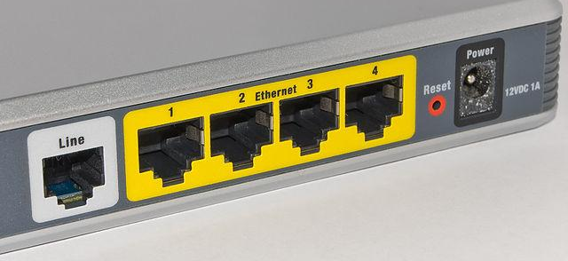
Efficient IP Lookup with Tries
Example: longest prefix of 00000
Start at ... (root) → no value stored here
Read bit 0, move to 0.. → has value (port 1) ← Remember this
Read bit 0, move to 00. → no value (just a path node) ← Keep port 1 as best
Read bit 0, try to continue → no child exists, fall off the tree
Return the last valued node (blue node) seen: 0.. (port 1)
Physical port: The hole you plug a cable into. Exists in hardware.
Key (IP Addr) | Value (Port #)
0.. | 1
100 | 2
101 | 3
11. | 4
001 | 5
Longest prefix of 00000 is 0.
...
0..
1
1..
00.
10.
11.
4
Even though 00 is a prefix of 00000, it is not stored as a key (00. has no value in the trie), so it doesn't count as a match. The longest stored prefix that matches is 0, so the packet is forwarded to port 1
001
5
100
2
101
3
Notes:
You keep track of the last such node you saw. When you fall off the tree or finish the address, you return the longest (deepest) dotted prefix
Return the longest key you saw.
Prefixes correspond to blue nodes where a value is stored, not necessarily leaves.

Slide 39
Efficient IP Lookup with Tries
Example: longest prefix of 00100:
Start at ... (root) → no value stored here
Read bit 0, move to 0.. → has value (port 1) ← Remember this
Read bit 0, move to 00. → no value (just a path node) ← Keep port 1 as best
Read bit 1, move to 001 → has value (port 5) ← Update to this (more specific)
Read bit 0, try to continue → no child exists, fall off the tree
Return the last valued node (blue node) seen: 001 (port 5)
Key | Value (Port #)
0.. | 1
100 | 2
101 | 3
11. | 4
001 | 5
Longest prefix of 00100 is 001.
...
0..
1
1..
00.
10.
11.
4
001
5
100
2
101
3
Notes:
so instead of the key being words like sam
1:01:09
and alls the keys are no longer words they are IP prefixes see Zero dot dot
1:01:15
that's an IP prefix one0 that's also an IP prefix 11 one dot also an IP prefix
1:01:22
so instead of English words we now have the keys as IP prefixes and they are bit
1:01:28
strings that you can spell out one by one just like an English word but instead of the alphabet being a through
1:01:34
z the alphabet is now zero or one so it's kind of like what you would expect
1:01:40
and then the value is no longer I have no idea what these numbers were but the value is now Port so we're saying if an
1:01:49
IP address is in the range 0 dot dot so anything from 0 00 0 to 011 please send
1:01:55
it out of Port one and if anything is in the range 001 that's an exact range it's
1:02:01
just one IP address send it out of port five that's how you read this table it
1:02:06
is the same as this forwarding table but I did not have space to write 32 bits so I wrote three but you can imagine this
1:02:13
could be extended to 32 bits no problem so if I have a map like this I
1:02:20
can do the same trick as before and build the try with these entries so how
1:02:25
do I do it the Top Root has nothing spelled so far so it's dot dot dot representing all the
1:02:31
bits unet for the first entry it's zero dot dot yeah so I spell zero and I'm
1:02:37
done so I mark it blue to indicate that that is the end of a prefix and I write the associating Port which is one okay
1:02:45
the next entry is one0 0 so I start at the top I spell one0 zero that takes me
1:02:51
down here I color this node blue and I map it to Port two and along the way I
1:02:56
created this intermediate node and this intermediate node they are white because they are not the end of a prefix okay
1:03:03
now I spell one one for the next entry so I reuse this one dot dot I reuse this one zero Dot and I get to one one maps
1:03:11
to port number three and you see where this is going I can spell one one for
1:03:17
fourth entry and I can spell Z 0 one for the fifth entry and I'm all done that's
1:03:23
how you build the try you spell the entries one by one and you build the try now the second interesting thing is
1:03:29
looking things up in the try to do longest prefix matching you pull the exact same trick that we did with sample
1:03:36
and Sam you spell the IP address bit by bit and then you keep track of all the
1:03:43
matches you saw and when you fall off the tree or you're done spelling return the longest key that you saw so for
1:03:49
example let's say I want to send something to IP address 0010 in reality this should be 32 bits

Slide 40
Efficient IP Lookup with Tries
Default route example: longest prefix of 10100
Routers usually have a default route 0.0.0.0/0 for unmatched traffic
Start at ... (root) → has value (port 1, default route) ← Remember this
Read bit 1, move to 1.. → no value (just a path node) ← Keep default as best
Read bit 0, move to 10. → no value (just a path node) ← Keep default as best
Read bit 1, try to move to 101 → node doesn't exist, fall off the tree
Return the last valued node (blue node) seen: ... (default, port 1)
...
1
Longest prefix of 10100 is …(the default route)
Key | Value (Port #)
... | 1
0.. | 2
11. | 3
100 | 4
0..
2
1..
10.
11.
3
Even though 10 is a prefix of 10100, it is not stored as a key (10. has no values in the trie). Since no more specific stored prefix matches, the packet is forwarded using the default route to port 1.
100
4
Notes:
to prevent it from circulating endlessly.
If you see another prefix, it will be returned over the default route. If even that is missing, the packet is discarded (dropped)

Slide 41
Efficient IP Lookup with Tries
Runtime of longest prefix matching in a trie:
Runtime is O(k), where k is the address length; for IPv4, k = 32, so lookup is constant with respect to table size.
We'll only visit at most 32 nodes for an IPv4 address.
All routers have efficient longest prefix matching functionality.
Some use more complex solutions with heuristics and optimizations.
Some destinations are more popular than others.
Some ports have more destinations.
Longest prefix to external networks is /24 (e.g. you won't see a 29-bit prefix).
We could optimize for fast trie/table updates too.
Notes:
1:09:37
great so how do you actually find the runtime of this thing because remember if we go all the way back the original
1:09:44
problem of looking through the entire table was that it ran an end time where
1:09:50
n is the number of entries in your table so it ran in O of n time where you had
1:09:55
to scan through everything in the table that was way too slow so a somewhat
1:10:00
surprising fact is that the runtime of a try is not o of n it is O of one it is
1:10:07
constant no matter how many entries you have and the way that I see that is how
1:10:12
did you do longest prefix matching you spelled the IP address you started at the top and you spelled the address one
1:10:19
after the other going all the way down in the worst case if you spelled all the
1:10:25
way to to the bottom of the tree you would spell 32 different digits because
1:10:30
IP addresses are 32 bits assuming ipv4 so at most you're only ever going to
1:10:36
touch 32 nodes as a result of spelling out 32 different digits even if the tree
1:10:43
itself is enormous like exponential number of entries it doesn't matter
1:10:48
because every time you do longest prefix matching which is what you have to do for forwarding you just walk down this
1:10:54
tree 32 numbers done so now there's no more scaling with the size of the table
1:10:59
the table could be enormous the TR itself could be enormous and it doesn't matter no matter how big the try is if

Slide 42
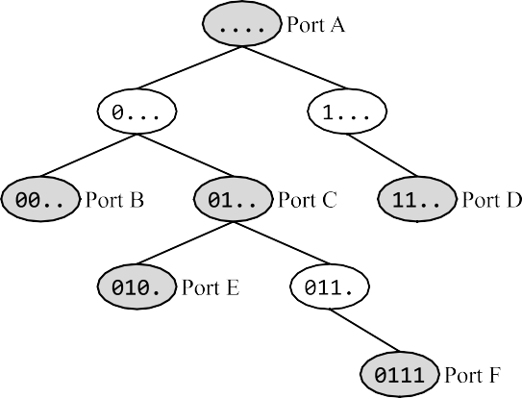
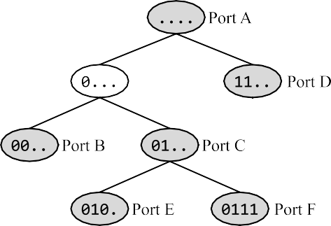
Patracia Tries (not covered in midterm)
One downside of binary tries is that they can get too tall.
In a Patricia trie, all nodes that are not assigned a port (colored white below) with a single parent and a single child are compressed. Example of converting a binary trie into its corresponding Patricia trie:
Binary Trie
Patricia Trie

Slide 43
Summary: IP Routers
Routers have different planes.
Data plane: Forward packets.
Control plane: Programming forwarding entries and handling exception packets.
Management plane: Configure and monitor router functionality.
Data plane leverages tradeoffs in software vs. hardware packet processing.
Software: Flexible but slow.
Hardware: Inflexible but fast.
Data plane challenges: Speed!
Some operations are easy, e.g. update packet header.
Use tries for efficient longest-prefix lookup on destination address.

